Slide 1
Meiosis
Lecture 20

Slide 2
Objectives
Describe briefly meiosis I and meiosis II
Describe the changes in the amount of DNA per cell starting from S phase until the end of meiosis II
Be able to define, describe, and understand
compare mitosis and meiosis using the following criteria: the Number of divisions, synapses of homologous chromosomes, daughter cell number & genetic composition, and roles in the body
locus
allele
haploid genome
diploid genome
homozygous diploid
heterozygous diploid
haploid cells
gametogenesis
fertilization

Slide 3
Haploid & Diploid
Many multicellular eukaryotic species are sexually reproducing
They have parents: a "mom" & "dad" / male & female
Sexual reproduction provides genetic variation that helps give species a survival advantage
They inherit a set of chromosomes from two parents
The two sets of chromosomes in the cell makes cells diploid
Sexual reproduction requires a process (meiosis) that produces gametes that have the haploid state in the individual of one sex to combine with gametes with individual of the other sex
When gametes join (the fertilization process), if they did reduce ploidy by half, then DNA content of cell would be unmanageable

Slide 4
Meiosis I
The "reduction division"
because this takes cells from diploid (2n) to haploid (n) state
Prophase I
Genetic recombination occurs in prophase: "mixing" of parental genes on paired chromatids by homologous recombination
Metaphase I
The homologous pairs line up on the equator of the spindle
in mitosis all chromosomes line on the equator; pairing of homologues does not occur
Anaphase I
The homologous pairs migrate to spindle poles and become daughter cells
There is no sister chromatid separation at centromeres
Telophase I / cell division
The DNA content is 2C and the cells are now haploid (n)

Slide 5
Meiosis II
There is NO S phase (DNA replication) between Meiosis I and II
DNA content remains at 2C
Prophase II
Almost imperceptible since chromosomes really do not have to de-condense as if in interphase
Metaphase II
All chromosomes, as in mitosis metaphase, are aligned on the spindle equator
Anaphase II
Sister chromatids separate at centromeres just as in mitosis anaphase
Telophase I / cell division
The DNA content is 1C and the cells are still haploid (n)

Slide 6
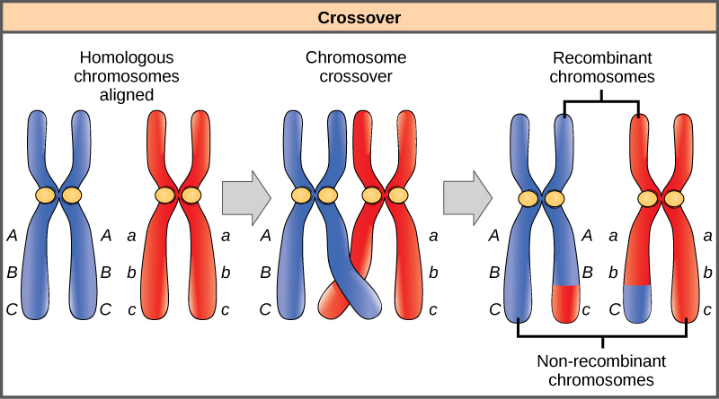
Homologous Recombination
Homologous chromosomes (from each parent) line up as spindle forms
In process called synapsis, arms of chromatids from each pair exchange DNA strands
This creates genetic variation for the species

Slide 7
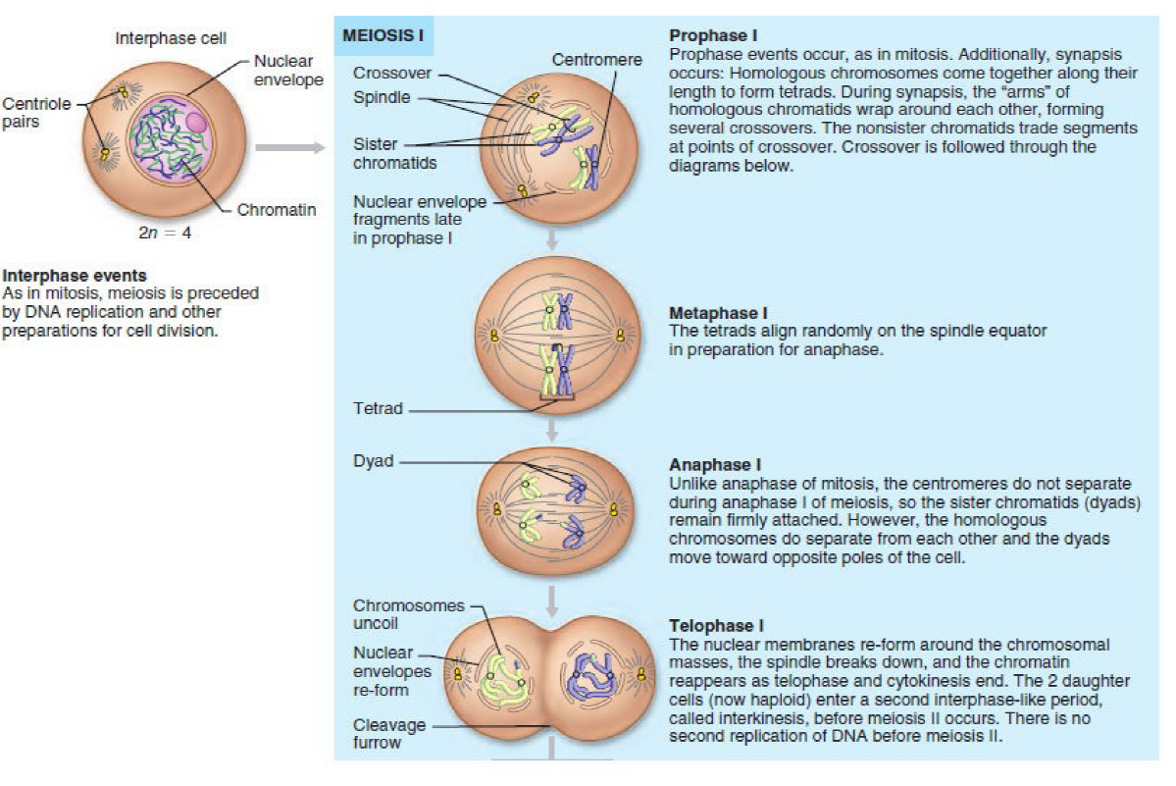

Slide 8
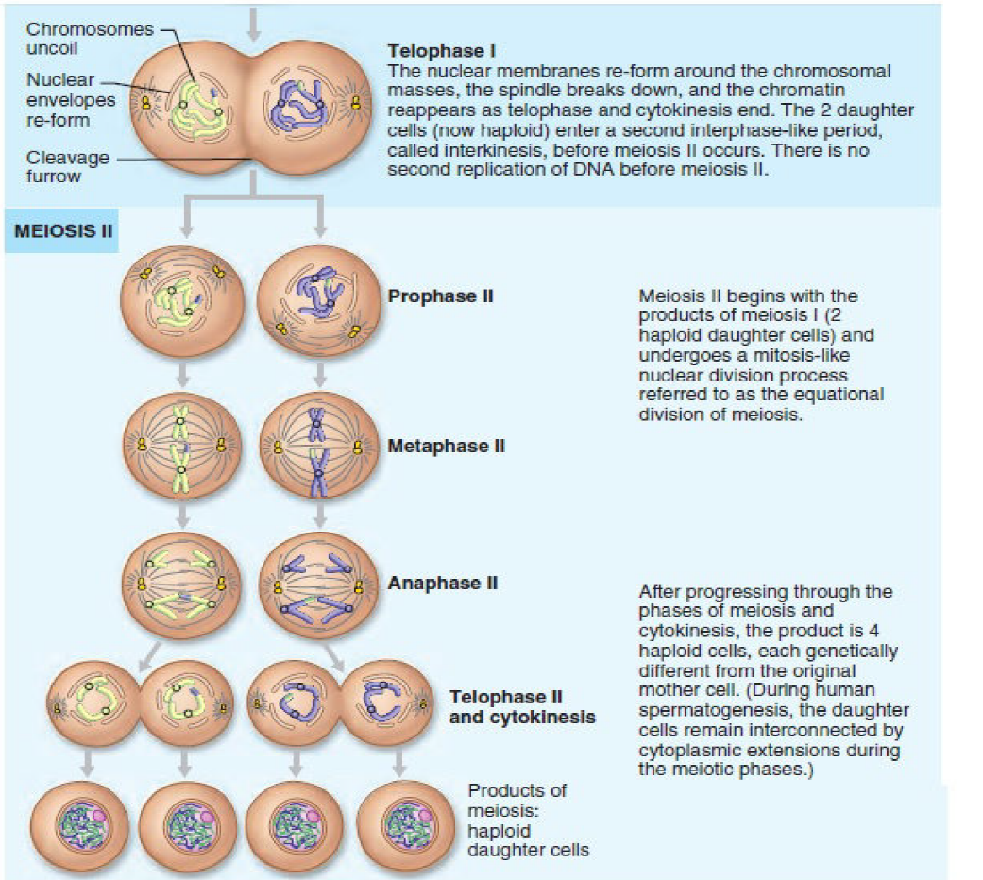

Slide 9
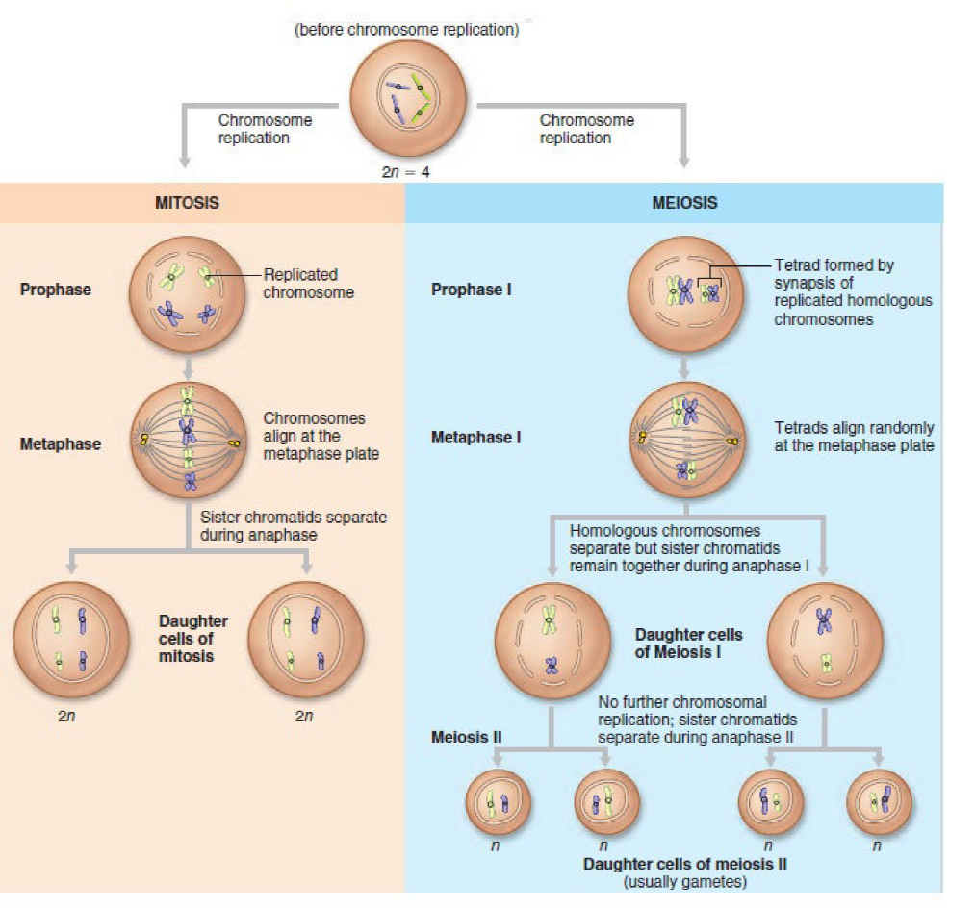

Slide 10
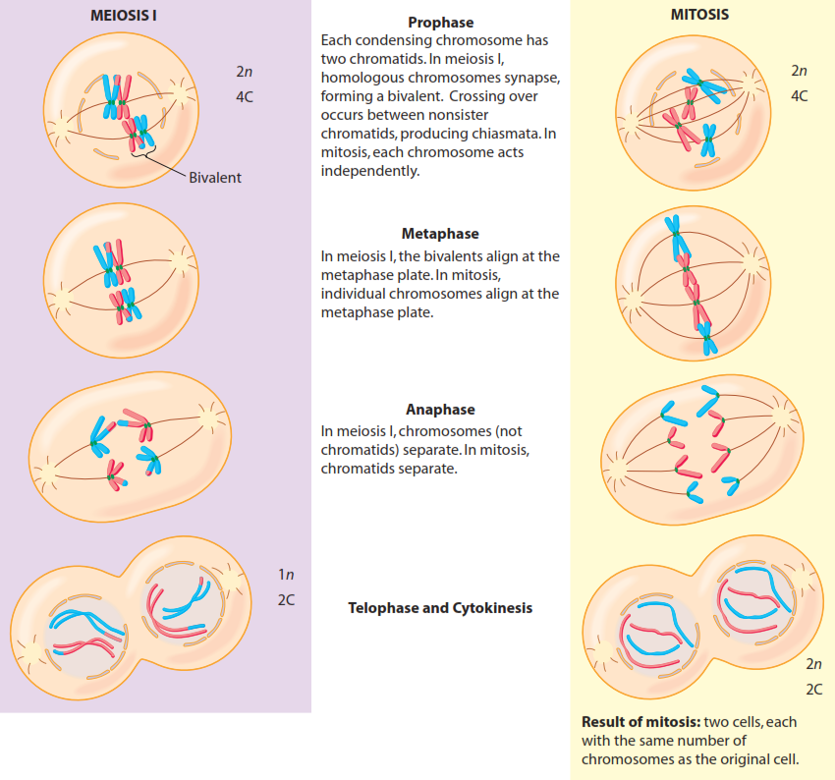

Slide 11
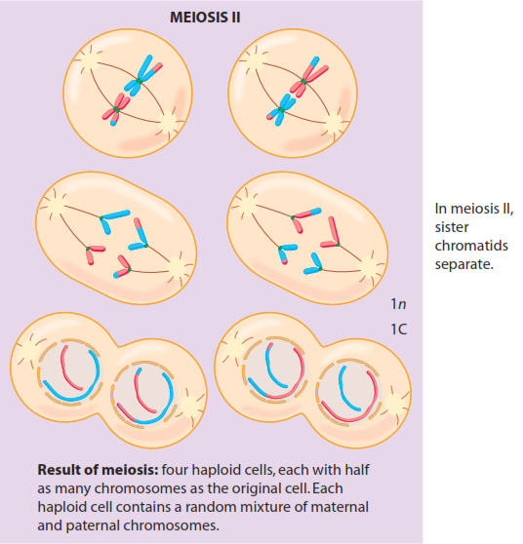

Slide 12
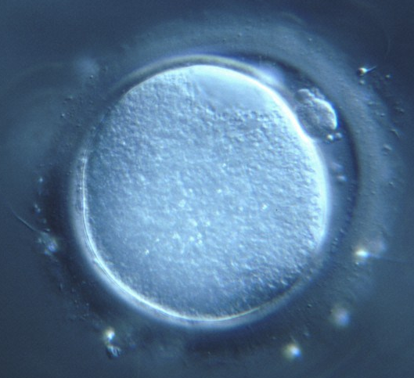
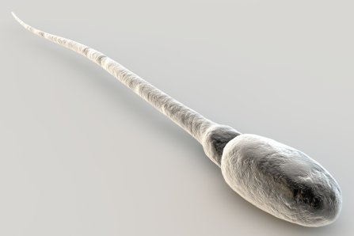
Gametogenesis
The production of gametes includes the process of meiosis
Because meiosis starts with a single cell in the diploid state with newly replicated DNA (went through S phase), its first division produces two haploid cells that undergo a mitotic-like division in meiosis II to produce four haploid cells
With the four cells made, they undergo differentiation to complete gametogenesis
each cell in a human female can become an ovum
each cell in a human male becomes a spermatozoon
Gametes ARE haploid cells

Slide 13
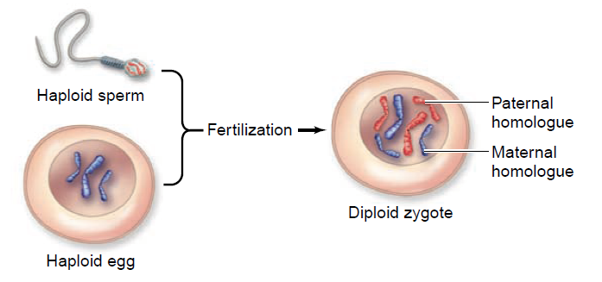
Note that the spermatozoon has red-colored chromosomes and the ovum has the blue-colored chromosomes
These haploid cells (gametes) will join in fertilization to form the diploid cell

Slide 14
Quick Molecular Mendel
In the previous slide on homologous recombination as shown by chromosomal crossover, the places marked with letters represent the loci of genes
Genes are involved with traits, but genes are molecularly represented as sequences on DNA in chromosomes. A locus is the molecular place where a gene resides on the chromosome
The DNA sequences of genes can have variation: e.g. the gene for eye color can have different DNA sequences, one which produces blue eye color and another producing brown eye color
Variation in a gene is called an allele: molecular geneticists see variation as difference one or more bases of a DNA sequence coding the gene

Slide 15
Homozygous & Heterozygous
The gene for eye color has two alleles: B for brown and b for blue
Because of the diploid state, two alleles are possible for a gene
So with eye color, we can have the following possible pairs of alleles or genotypes: BB, Bb, and bb
When the alleles in genotypes are identical, such as BB and bb, these are called homozygous (diploid)
When the alleles in genotypes are different, such as Bb, these are called heterozygous (diploid)

Slide 16

Genotypes
The genotype of a single gene of an organism are the symbolic representations of the two alleles it has
Suppose a gene has two alleles, W and X: it can form WW, WX, and XX for the diploid set
If it has three possible alleles, W, X, and Z, then it can form 6 possible genotypes WW, WX, XX, WZ, XZ, and ZZ for the diploid set
$G=\frac{a(a+1)}{2}$ G = #genotypes possible, a = # alleles

Slide 17
Dominant, Recessive & Phenotype
In Mendelian genetics, some alleles for MANY but NOT ALL genes show dominance
In eye color, those with the brown allele (B) show brown eyes even though their other allele in the diploid genome is blue (b): the B allele is dominant over the b allele
Individuals with BB and Bb genotype show brown eyes; those with bb genotype show blue eyes
The brown eye color is dominant and the blue eye color is recessive
The phenotype is how the genotype expresses itself:
BB & Bb genotypes → brown eye color phenotype
bb genotype → blue eye color phenotype

Slide 18
Mendel → Molecule
Keep in mind that Mendel knew nothing of the molecular details of how genes (traits) were organized as DNA sequences on chromosomes
We can now understand dominant & recessive phenotypes and alleles as changes in the qualitative (presence or absence) and quantitative (low or high) expression of proteins coded by DNA
As many as 16 different genes (not merely alleles) are involved in determining the coloration of the iris, although there are two main genes with one regulating the other that provide what we see as generally brown eyes and variations on blue eye color

Slide 19
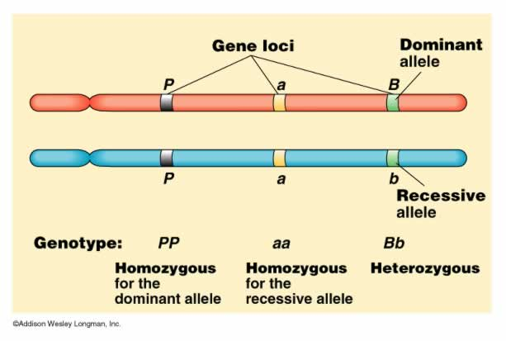

Slide 20
Comparing Mitosis & Meiosis
 | Meiosis I | Meiosis II | Mitosis
S phase | DNA: 4C diploid (2n) cells | no S phase | DNA: 4C diploid (2n) cells
prophase: homologous recombination | synapsis + crossing over | as in mitosis | doesn't happen
metaphase: equatorial alignment | homologous pairs (bivalents) | as in mitosis | all chromosomes
anaphase: separation | one chromosome of the homologous pairs | as in mitosis | sister chromatids
daughter cells | DNA: 2C haploid (n) cells | DNA: C haploid (n) cells | DNA: 2C diploid (2n) cells

Slide 21
Reading (Sources)
Becker's WotC: pp 602-611
Raven: pp 207-217

